Slide 1
Introductory General Chemistry
Chemistry 3A
S. M. Halloran

Slide 2
Scientific Method
Atomic Theory
Subatomic Structure: protons, electrons, neutrons
Atomic Properties
Patterns of matter: Periodic Table
Electric properties of atoms: ions
Neutrons and isotopes
Atomic mass: weight average of atoms
Review

Slide 3
Scientific Method

Slide 4
Atomic Theory

Slide 5
Subatomic Structure
Protons, electrons, neutrons

Slide 6
Atomic Properties

Slide 7
Patterns of Matter: Periodic Table

Slide 8
Electric properties of atoms: ions

Slide 9
The Atom
Atoms are made of three subatomic particles
Protons
which actually give the element its identity
Electrons
chemistry is really about electrons, because it is electrons that allow atoms to bond to each other
Neutrons
it takes about 1800 electrons to equal mass of a proton, and the neutron is slightly bigger than the proton by 0.15%.
Because neutrons have a mass that is slightly higher than sum of a proton & electron, and because neutrons have been shown to decay to a proton, electron, and some other particles in physics, speculation is that a neutron is special gluing of a proton and electron.

Slide 10
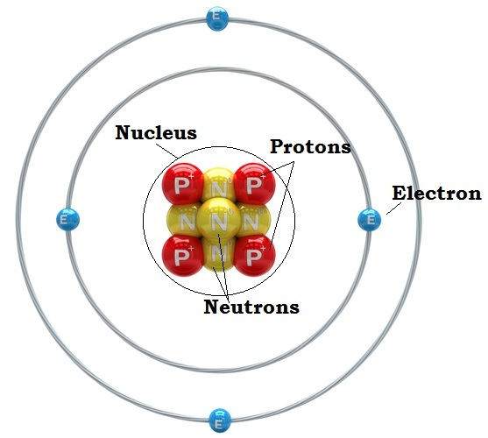
Nucleus & Orbitals
Protons and neutrons organized in the nucleus
Electrons spatially located outside of the nucleus
Electrons "orbit" the nucleus in orbitals but not like planets revolving around the sun
Their position/location is determined by probabilities calculated by complex mathematical expressions
Each orbital pairs two electrons of opposite spin
Yes, electrons have a spin just as the Earth rotates on an axis, and this spin generates a magnetic field

Slide 11

Atomic Weight
Why does hydrogen (H) have an atomic weight of 1.0079?
How is it calculated?

Slide 12
Atomic Weight Explained
Atoms are made of three subatomic particles
Protons
which actually give the element its identity
Electrons
chemistry is really about electrons, because it is electrons that allow atoms to bond to each other
Neutrons
it takes about 1800 electrons to equal mass of a proton, and the neutron is slightly bigger than the proton by 0.15%.
In fact, a neutron may be the combination of the mass of both 1 proton and 1 electron plus the Einstein energy (E = mc²) necessary to slam them together.
Neutrons can undergo radioactive decay into a particle that is +1 (proton or anti-proton) and –1 (electron) particles

Slide 13
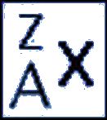
Atomic Weight Explained
Elements all have the same number of protons
But elements can have different number of neutrons
An element with different numbers of neutrons is an isotope of the element
When referring to an isotope of an element, use this
Where
× is element symbol (e.g, hydrogen = H)
A is atomic number, = # protons (A = 1 for H)
Z is mass number, = #protons + #neutrons

Slide 14
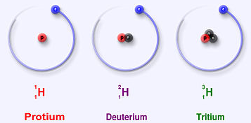
Atomic Weight Explained
Hydrogen has three isotopes:
Protium (¹₁H)
1 proton, 0 neutrons
usually just called "hydrogen"
99.9885% of all hydrogen isotopes in nature is this isotope
Deuterium (²₁H)
1 proton, 1 neutron
It is a stable isotope
0.0115% of hydrogen isotopes is deuterium in nature
Tritium (³₁H)
1 proton, 2 neutrons
It is an unstable isotope, meaning it is radioactive
Probably less than 0.00000001% in nature

Slide 15
Atomic Weight Explained
Atomic weight is calculated by taking the mass of each isotope in atomic mass units and multiplying it by the abundance of each, then summing it all up
Thus
1.007825032 × 0.999885 + 2.0141017778 × 0.000115
= about 1.0079!
Isotope | Mass (amu) | Abundance
¹₁H | 1.007825032 | 0.999885
²₁H | 2.0141017778 | 0.000115

Slide 16
The Periodic Table

Slide 17
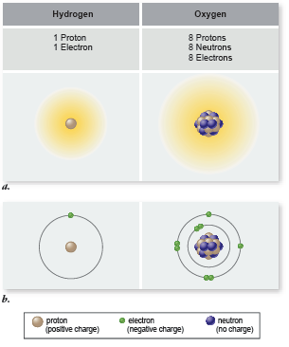
Elements
Elements all have the same number of protons
But elements can have different number of neutrons
An element with different numbers of neutrons is an isotope of the element
When referring to an isotope of an element, use this
Where
× is element symbol (e.g, hydrogen = H)
A is atomic number, = # protons (A = 1 for H)
Z is mass number, = #protons + #neutrons

Slide 18
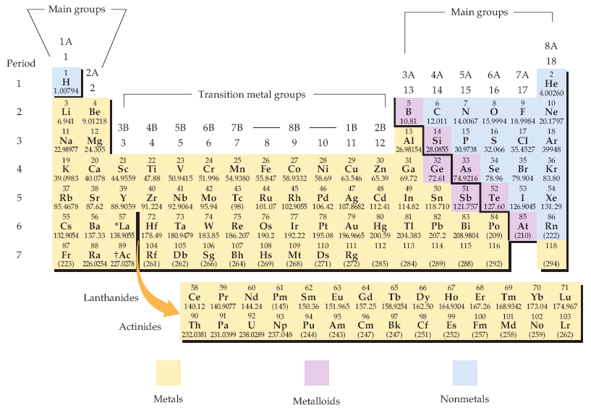
Periodic Table of Elements
Biologists should know what elements are (1) metals and (2) nonmetals generally
The periodic table of the elements. Each element is identified by a one- or two-letter symbol and is characterized by an atomic number. The table begins with hydrogen (H, atomic number 1) in the upper left-hand corner and continues to the yet unnamed element with atomic number 118. The 14 elements following lanthanum (La, atomic number 57) and the 14 elements following actinium (Ac, atomic number 89) are pulled out and shown below the others.
Elements are organized into 18 vertical columns, or groups, and 7 horizontal rows, or periods. The two groups on the left and the six on the right are the main groups; the ten in the middle are the transition metal groups. The 14 elements following lanthanum are the lanthanides, and the 14 elements following actinium are the actinides; together these are known as the inner transition metals. Two systems for numbering the groups are explained in the text. Those elements (except hydrogen) on the left-hand side of the zigzag line running from boron (B) to astatine (At) are metals, those elements to the right of the line are nonmetals, and most elements abutting the line are metalloids.
McMurry et al, Fundamentals of General, Organic and Biological Chemistry, 6 Ed, p 58

Slide 19
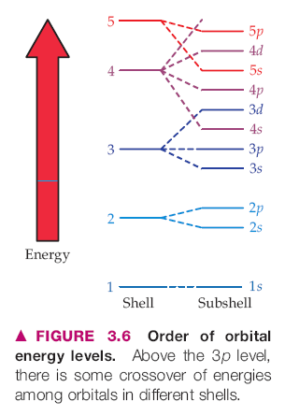
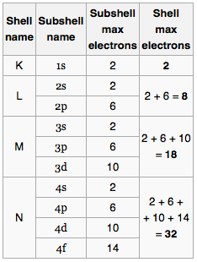
Shells of Electrons & Periodic Table
Each period (row) of the Periodic Table corresponds to a "shell" of electrons
Shells are designated by the principal quantum number n by chemists: n = 1, 2, 3, …
letters K, L, M, N, O, … by physicists
Within the shells are subshells: s, p, d, f
In quantum chemistry/physics, each electron is described by a set of four quantum numbers: {n, l, m_{l}, m_{s}}
There is a correspondence between a shell's energy and its shell number/letter (distance from nucleus): higher shell number relates to higher energy of the electron
The maximum number of electrons in each shell (period) is 2, 8, 8, 18, 18, 32, 32, ..

Slide 20
Empirical Formula from Percent Composition
You will need the atomic weights (from the periodic table) of all component atoms
Assume you have 100 grams of the compound/molecule: calculate the number of grams of each component atom from the percent of the component atom
From each component atom mass in grams, compute the number of moles of each component atom
Compute the relative mole ratios of all component atoms to the one component atom with the lowest mole value
That is, divide the mole values of all component atoms by the atom with the lowest mole value

Slide 21
Empirical Formula from Percent Composition
Worked Example #1
Percent composition of copper chloride is 64.1% Cu and 35.9% Cl. What is empirical formula?
That is we want to know × and y of Cu_{x}Cl_{y}
atomic weights: Cu = 63.546 g/mol, Cl = 35.453 g/mol
Component atom masses in grams of 100 grams of copper chloride:
(0.641)(100 g) = 64.1 g Cu (0.359)(100 g) = 35.9 g Cl
iii) # moles of each component atom: (64.1 g Cu)(1 mole/63.546 g Cu) = 1.01 ~ 1
(35.9 g Cl)(1 mole/35.453 g Cl) = 1.01 ~ 1
iv) dividing by lowest mole value since both are equal to 1, they are both equal in mole content. So empirical formula is CuCl

Slide 22
Empirical Formula from Percent Composition
Worked Example #2
Trichloroethylene (TCE) is 18.25% carbon, 0.77% hydrogen, and 80.99% chlorine by weight. What is empirical formula?
That is we want to know TCE with C_{x}H_{y}Cl_{z}
atomic weights: C = 12.011 g/mol, H = 1.008 g/mol, Cl = 35.453 g/mol
Component atom masses in grams of 100 grams of TCE:
C: (0.1825)(100 g) = 18.25 g C H: (0.0077)(100 g) = 0.77 g H
Cl: (0.8099)(100 g) = 80.99 g Cl
iii) # moles of each component atom: C: (18.25 g C)(1 mole C/12.011 g C) = 1.52
H: (0.77 g H)(1 mole H/1.008 g H) = 0.764
Cl: (80.99 g Cl)(1 mole Cl/35.453 g Cl) = 2.28
iv) dividing by lowest mole value C: 1.52 / 0.764 = 1.99 ~ 2, H: 0.764 / 0.764 = 1,
Cl: 2.28 / 0.764 = 2.98 ~ 3
Empirical formula: C₂HCl₃

Slide 23
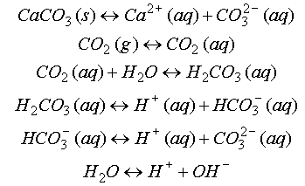
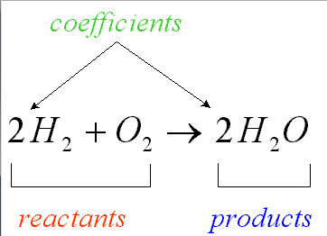
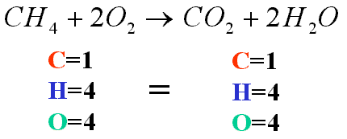
Balancing Mass & Charge
Laws of conservation of mass and electrical charge require that chemical (reaction) equations be balanced for mass and charge
http://ion.chem.usu.edu/~sbialkow/Classes/3600/Overheads/Carbonate/image020.gif
http://www.mikeblaber.org/oldwine/chm1045/notes/Stoich/Equation/balance4.gif

Slide 24
Atomic Weight Explained
Atomic weight is calculated by taking the mass of each isotope in atomic mass units and multiplying it by the abundance of each, then summing it all up
Thus
1.007825032 × 0.999885 + 2.0141017778 × 0.000115
= about 1.0079!
Isotope | Mass (amu) | Abundance
¹₁H | 1.007825032 | 0.999885
²₁H | 2.0141017778 | 0.000115

Slide 25
Ions
electrically charged atoms and molecules
ionized atoms: Na⁺, Cl–, K⁺, Ca²⁺, Mg²⁺
ionized molecules
H₃O⁺, HPO₄^{2–}, NH₄⁺ C₄H₄O₄^{2–} (succinate: molecular formula) –OOC-CH₂-CH₂-COO– (succinate: structural formula)
cations: positively charged ions
move toward cathode (– pole)
anions: negatively charged ions
move toward anode (+ pole)

Slide 26
The Molecule
Atoms that are covalently bonded to each other
Ionic compounds (and their solid forms crystals) (e.g. NaCl, table salt) are not molecules because the bonding is not covalent
A group of bonded atoms that are all non-metal atoms is a molecule

